Slide 1


TECHNICAL PRESENTATION CSA5112 CRYPTOGRAPHY AND NETWORK SECURITY
TOPIC: SUBSTUTIONAL VS TRANSPOSITION TECHNIQUE WHICH PROVIDES BETTER SECFURITY
Guided by:
Dr. E.Anbalagan
Presented by:
Logeshwari S (192565040)

Slide 2
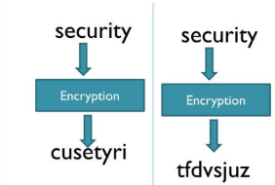
INTRODUCTION
What is Classical Encryption?
Classical encryption techniques protect confidential information by transforming plaintext into ciphertext.
Two fundamental techniques are:
Substitution Technique
Replaces each character with another character or symbol.
Transposition Technique
Rearranges the positions of characters without changing them.

Slide 3
Substitution Technique
What is Substitution?
Substitution encryption replaces each plaintext character with another character according to a fixed rule or secret key. The positions of the characters remain unchanged.
How it Works
Plaintext: HELLO
Using a Caesar Cipher (key= 3):
Encrypted Text: KHOOR
C=(P+K)mod26
P=(C−K)mod26
Plaintext | H | E | L | L | O
Ciphertext | K | H | O | O | R

Slide 4
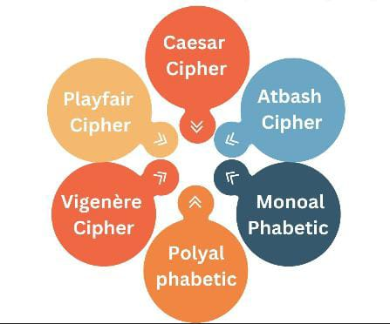
EXAMPLES Monoalphabetic Cipher Playfair Cipher Vigenère Cipher. Hill Cipher Advantages ✔ Hides the original characters (Confusion) ✔ Easy to implement ✔ More secure with complex substitution methods Limitations ✖ Simple substitution ciphers are vulnerable to frequency analysis.

Slide 5
TRANSPOSITION TECHNIQUE
What is Transposition?
Transposition encryption does not change the characters. Instead, it rearranges their positions using a secret pattern or key.
How it Works
Plaintext: HELLO
Rearranging the positions:
Reordered:
Ciphertext: HLOEL
Original Position | 1 | 2 | 3 | 4 | 5
Letter | H | E | L | L | O

Slide 6
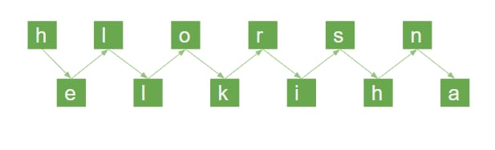
Examples
Rail Fence Cipher
Columnar Transposition
Advantages
✔ Hides the message structure (Diffusion)
✔ Difficult to interpret without the correct key
✔ More effective when combined with substitution
Limitations
✖ Character frequency remains unchanged, making it vulnerable to certain attacks if used alone.

Slide 7
Security Analysis Substitution vs Transposition
Security Aspect | Substitution Technique | Transposition Technique
Encryption Method | Replaces characters | Rearranges character positions
Security Principle | Confusion | Diffusion
Protects | Character identity | Character arrangement
Resistance to Pattern Recognition | High | Moderate
Resistance to Frequency Analysis | Better (especially advanced substitution ciphers) | Lower (letter frequencies remain unchanged)
Difficulty to Break | Higher | Lower
Standalone Security
Overall Verdict | 🏆 Better Security | Moderate Security

Slide 8
CONCLUSION
Substitution and Transposition are two fundamental classical encryption techniques.
Substitution secures data by replacing characters, while Transposition secures data by rearranging their positions.
Based on the security analysis, Substitution provides better standalone security because it hides the actual identity of the characters, making the ciphertext more difficult to interpret.
However, neither technique alone is sufficient against modern cryptographic attacks.
Modern encryption algorithms, such as DES and AES, combine substitution and transposition to achieve stronger security through both confusion and diffusion.

